Slide 1

Experience a Safer, Stress-Free Journey with Revolutionary Driving Monitoring Systems
הייתי משתמש בסיסמא הזאת להתחלה
HeartRay
PROPRIETARY & CONFIDENTIAL

Slide 2
Our Vision
HeartRay redefines the driving experience, through cutting-edge technology seamlessly integrating automotive safety, comfort, and health with precise, contact-free physiological measurements
HeartRay
PROPRIETARY & CONFIDENTIAL

Slide 3
HeartRay Value Proposition
Cutting-edge technology delivering precise medical grade physiological measurements
Diverse Physiological Data: HeartRay collects a variety of essential measurements, enabling a comprehensive understanding of the individual's condition
Software solution, seamless integration with any DMS :Compatible with both RGB/IR cameras
HeartRay
PROPRIETARY & CONFIDENTIAL

Slide 4

Actionable insights
Fatigue detection
Stress level monitoring
Thermal comfort optimization
Cognitive Stress
Motion sickness detection and mitigation
Key Health Indicator tracking
Arrythmia
Tachy/Brady cardia
PROPRIETARY & CONFIDENTIAL

Slide 5



Go-to-Market
PROPRIETARY & CONFIDENTIAL
OEMs & Tier-1
After Market
Off- highway
Enabling seamless integration
Driver-personalization solution
Fleet management
Driver stress escalates accident
Fleet management
Aviation, Trains, Scooters
Accurately measures driver stress and well-being
Optimize infotainment and temperature environment
Alerts fleet managers of unexpected incidents: stress anomalies, abnormal heart rates
Alerts fleet managers
Off-highway vehicle errors are costlier and deadlier.
Add on to helmets
PROPRIETARY & CONFIDENTIAL
PROPRIETARY & CONFIDENTIAL
PROPRIETARY & CONFIDENTIAL
HeartRay
PROPRIETARY & CONFIDENTIAL

Slide 6
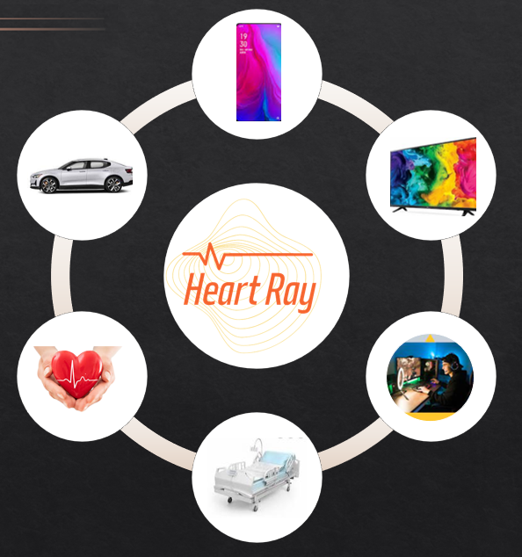

Potential markets
HeartRay
PROPRIETARY & CONFIDENTIAL

Slide 7
Go-to-Market
PROPRIETARY & CONFIDENTIAL
OEMs & Tier-1
After Market
Off- highway
PROPRIETARY & CONFIDENTIAL
HeartRay
PROPRIETARY & CONFIDENTIAL

Slide 8
Go-to-Market
PROPRIETARY & CONFIDENTIAL
safety
comfort
Health
Fatigue
stress
Thermal stress
Cognitive stress
Key health indicators
Arrythmia
Tachy / Brady cardia
PROPRIETARY & CONFIDENTIAL
HeartRay
PROPRIETARY & CONFIDENTIAL

Slide 9
Cutting edge
Technology
Precise medical grade
measurements
Seamless integration
with any DMS
Software
solution
Various
Physiological Data
enabling an understanding
of the individual's condition

